Slide 1



project on power bi bank domain
View in Power BI
Last data refresh:
11/1/2022 10:37:53 AM UTC
Downloaded at:
11/2/2022 5:56:22 AM UTC

Slide 2
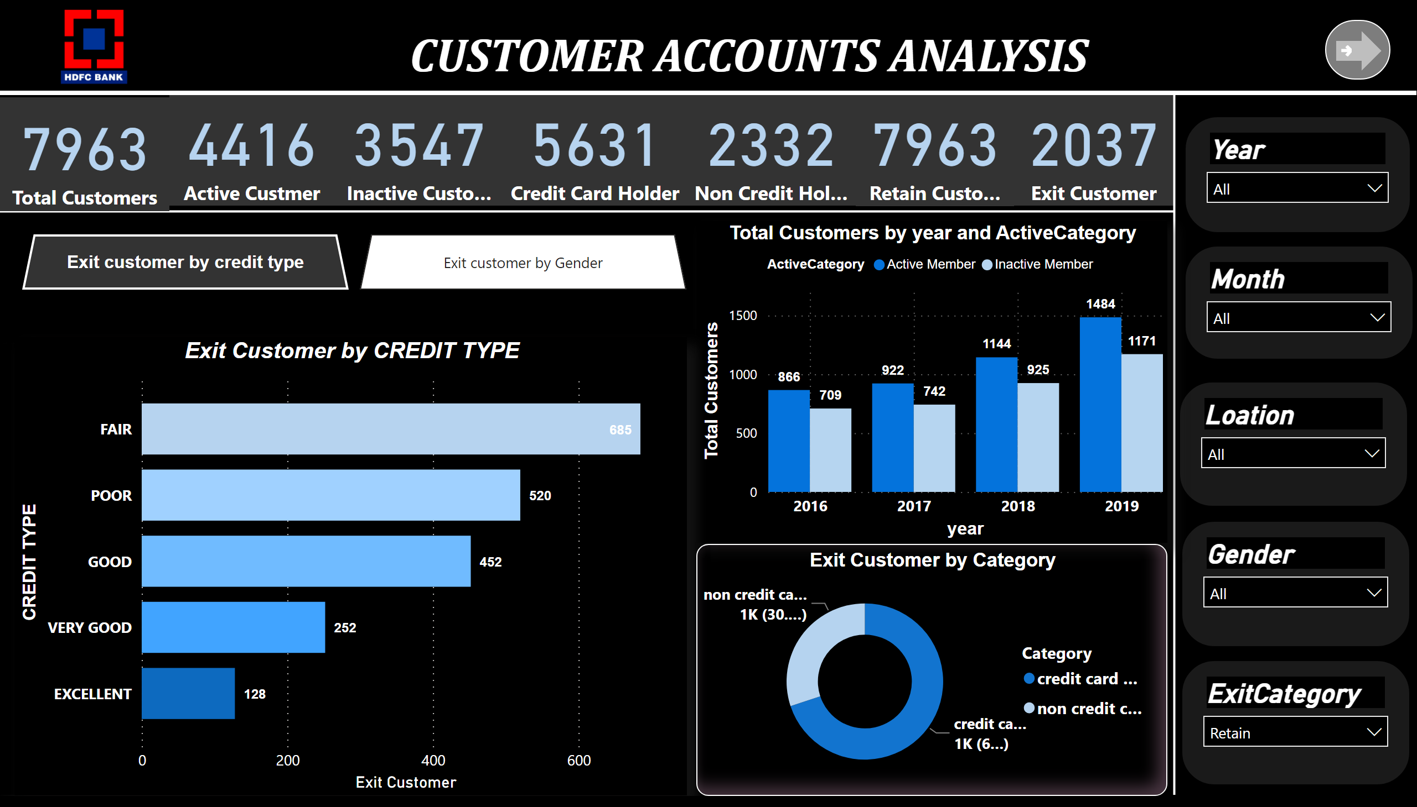
Page 1
Notes:
textbox
No alt text provided
image
No alt text provided
card
No alt text provided
card
No alt text provided
card
No alt text provided
card
No alt text provided
card
No alt text provided
card
No alt text provided
shape
No alt text provided
shape
No alt text provided
shape
No alt text provided
slicer
No alt text provided
slicer
No alt text provided
slicer
No alt text provided
slicer
No alt text provided
slicer
No alt text provided
clusteredColumnChart
No alt text provided
pieChart
No alt text provided
clusteredBarChart
No alt text provided
bookmarkNavigator
No alt text provided
actionButton
No alt text provided
donutChart
No alt text provided
card
No alt text provided

Slide 3
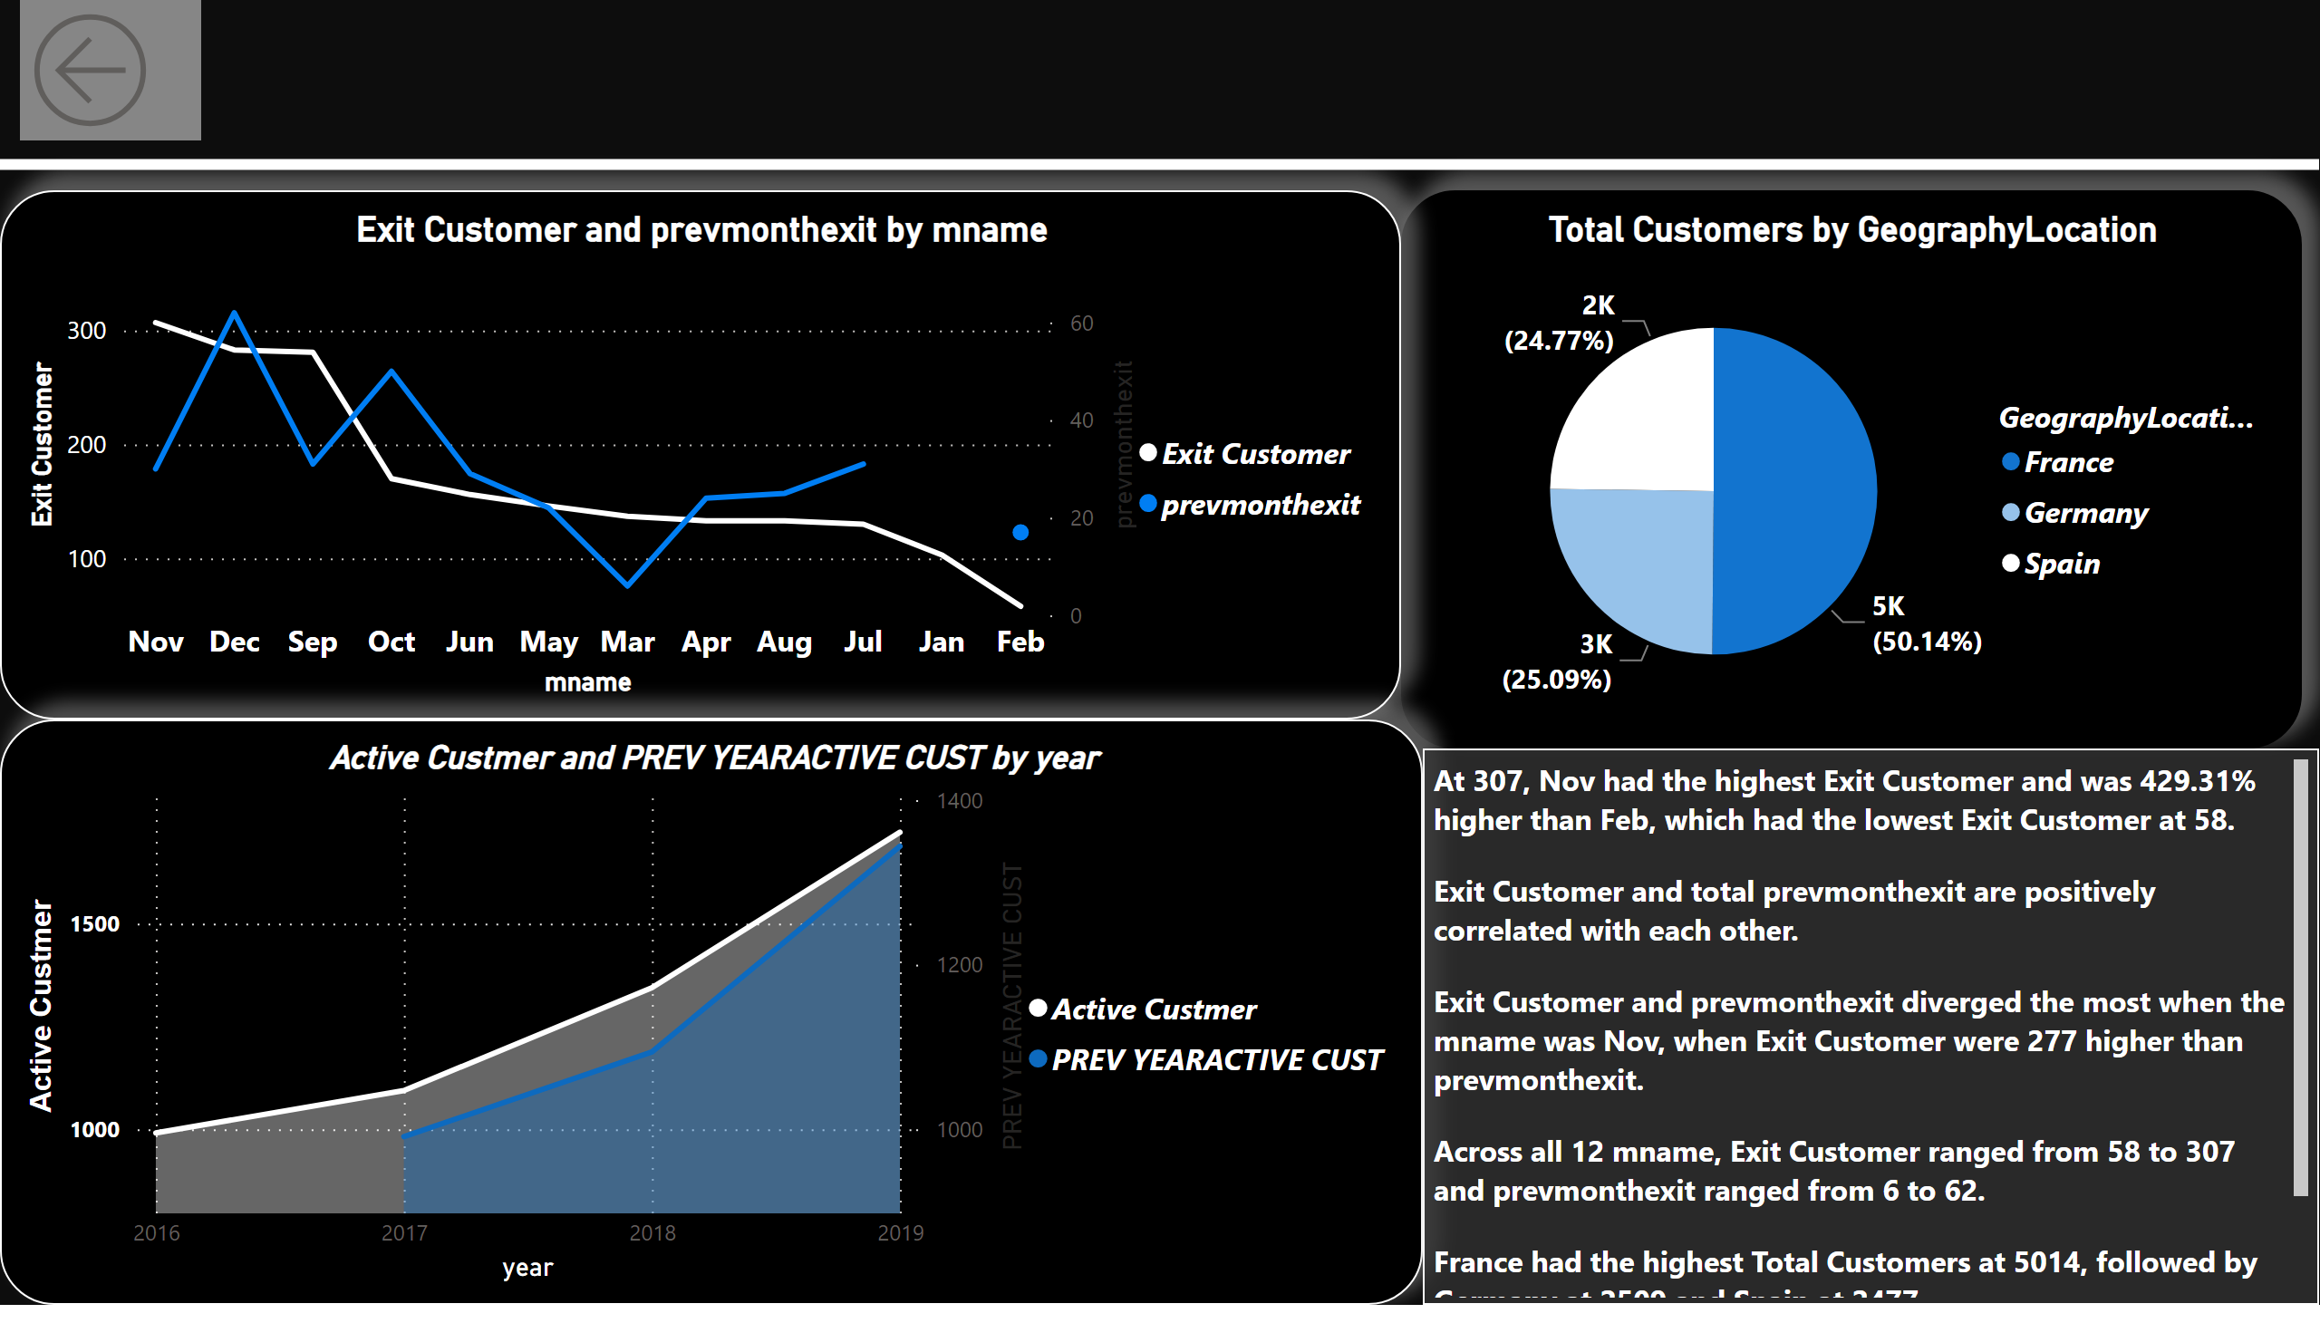
Page 2
Notes:
lineChart
No alt text provided
textbox
No alt text provided
shape
No alt text provided
actionButton
No alt text provided
areaChart
No alt text provided
pieChart
No alt text provided

